Slide 1
Glacier Melt Modelling
Final Project
Krishan Fotedar & Cristina Frisby

Slide 2
Agenda
Overview: Glacier Melting and AI/ML Data Analytics
Part A:
Image Processing & Prediction with Time Sequential Models
Part B:
Deep Neural Models to Predict Glacier Retreat

Slide 3
Image Processing & Prediction with Time Sequence Models
The objective is to develop a model that takes input from satellite images over time and predicts an image in the future.
We used the following:
Satellite Images from Greenland – Eight images spanning eight days
Create a Neural Network that takes in these images and produces a ninth image

Slide 4
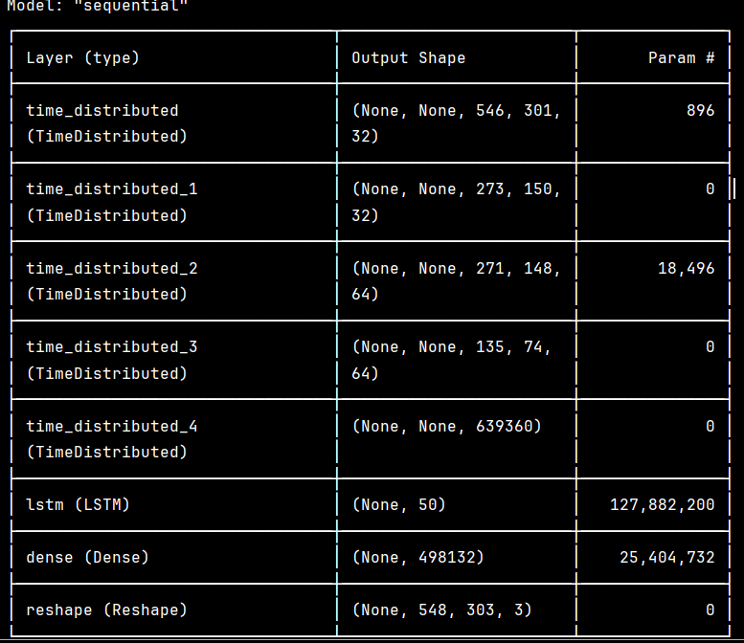
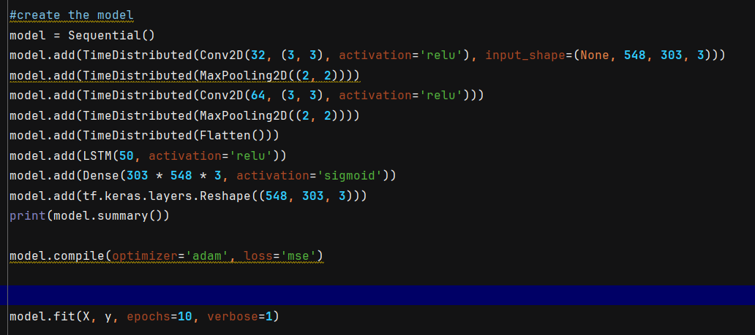
Image Processing & Prediction with Time Sequence Models
High-Level Procedure:
Read in 8 JPG images
Reduce the size by 90% and keep the scale – using them as is took too much RAM
Create a 4 Layer Neural Network with TensorFlow
I tried to use PyTorch but kept running out of RAM
Ran the model over 10 epochs

Slide 5
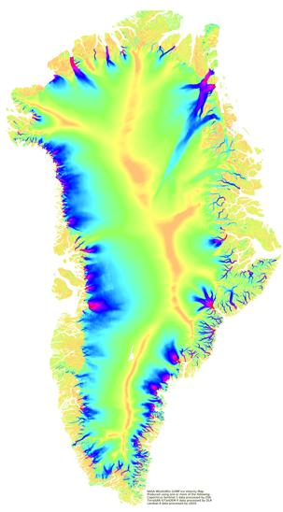
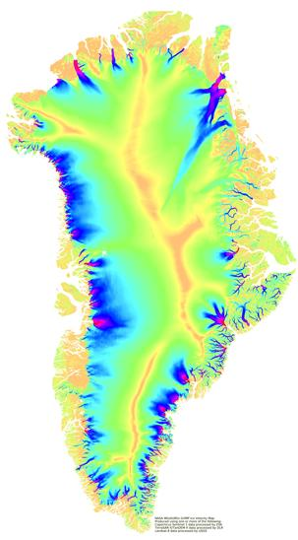
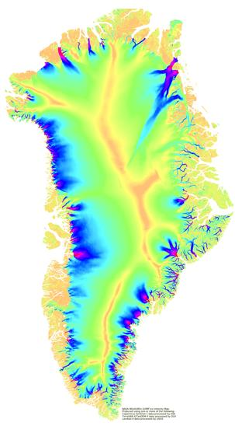
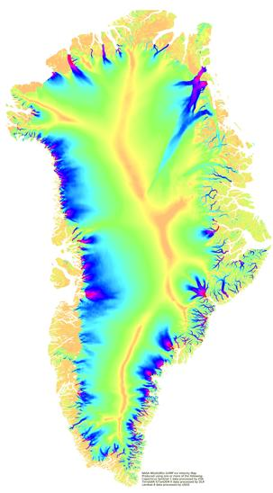



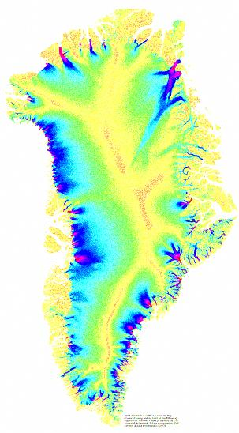
Image Processing & Prediction with Time Sequence Models
Input Data – 8 images spanning 8 days
Predicted Image

Slide 6
Image Processing & Prediction with Time Sequence Models
Observations and Future Work
Scale the model to be able to handle more data and predict over a period
Find a way to take the changes in color in the images and translate that into numeric data that can be used to measure changes in the geography (sea level, erosion etc.)

Slide 7
Glacier Modelling & Climate Change
Future Impact on Coastal Living and Business
Glacier Melting Contributes to Sea Rise
Glacier Change is Complex (Constant Motion)

Slide 8
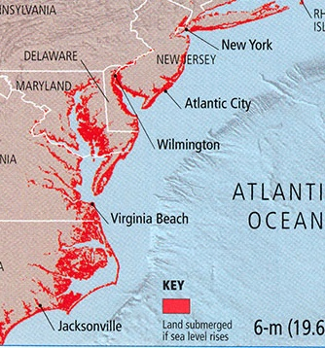

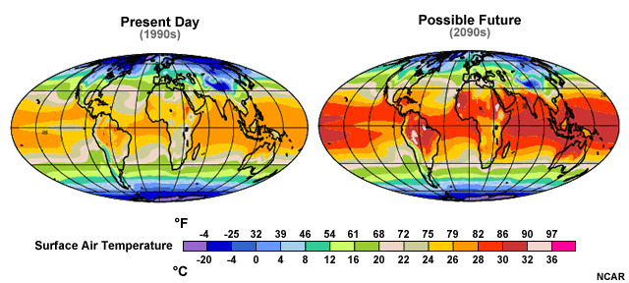
Ongoing Research and Science
Modelling Climate Change to Predict Future Issues
Temperature Rise
Sea Rise
Land Cover
Food Production
Housing
Economics

Slide 9
Title and Content Layout with Chart

Slide 10
Two Content Layout with Table
Class | Group A | Group B
Class 1 | 82 | 85
Class 2 | 76 | 88
Class 3 | 84 | 90
First bullet point here
Second bullet point here
Third bullet point here

Slide 11
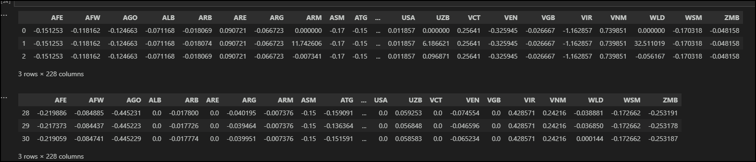
Part B: Predicting Glacier Retreat
Available Climate Change Data
Glacier Retreat:
7M sq km (1973) 4.4M sq km (2023)
CO2 Global Levels:
336ppm (1979) 419ppm (2023)
Data from Over 200 Countries:
Population, Temperature, Forestation, Economy

Slide 12
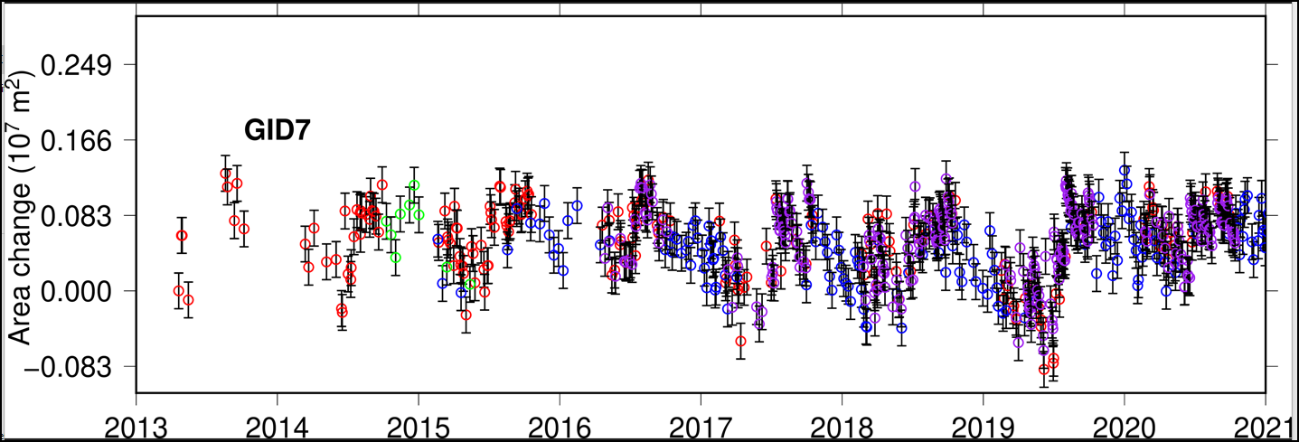
Part B: Predicting Glacier Retreat
Model Summary
Pre-processing: Data Discovery, Concatenation, Cleaning, StandardScaler (scikit-learn) for Features Set (X)
Deep Neural Model: Tensorflow’s Keras Categorization
Target Set “y” : Will Glaciers Retreat This Year?
Retreat (0) Not Retreat (1)
Glacier Data indicates that Glacier Movement is Constant: Retreat and Grow annually and seasonally, challenging models.
https://nsidc.org/data/nsidc-0788/versions/1#anchor-data-access-tools

Slide 13
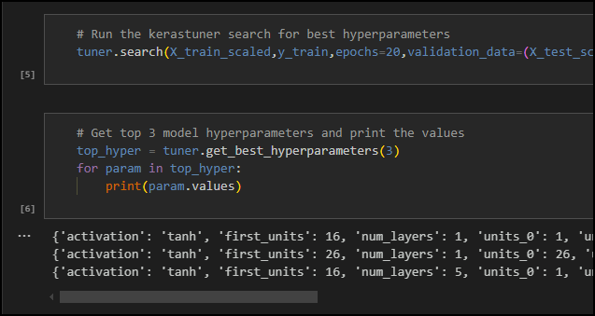
Part B: Predicting Glacier Retreat
Model Summary
Four Different Models with 4 Different Data Sets
Iterations included: Keras Tuner Hyperparameter Input
For “Model 3” with 150 Parameters
hidden_nodes_layer1 = 11
hidden_nodes_layer2 = 6
hidden_nodes_layer3 = 16
hidden_nodes_layer4 = 11
This lead to a better first pass than the other models’ first
pass but still was limited in performance.
Keras Tuner Predicted:
Loss: 0.50, Accuracy: 0.90
Keras Tuner Actual First Pass:
Loss: 1.16, Accuracy: 0.66
Model 1 Climate Change Parameters Loss: 0.67, Accuracy: 0.64
Model 2 Population, Farm, and Finance Parameters Loss: 0.74, Accuracy: 0.55
Model 3 Change in Temperature Parameters Loss: 0.85, Accuracy: 0.77
Model 4 Deforestation Parameters Loss: 91.3, Accuracy: 0.60

Slide 14
Part B: Predicting Glacier Retreat
Future Work
1. Finding larger sources of data, possibly on the monthly, weekly, or even daily level that could contribute to more data faster.
2. Shifting the results in time, lead or lag, in case the responses are different in time.
3. Including parameters such as snowfall in the analysis.
4. Using other models such as linear regression and Prophet with glacier area change, instead of classification models
5. Using Keras Tuner as the preliminary model for each set of parameters.

Slide 15
Glacier Melt Modelling
Questions?

